Slide 1
Project team ID : PTID-CDA-NOV-24-244
PRDA – 01 Profit Analysis
Team Members :
NIKHIL EKHANDE nikhilekhande2@gmail.com
Pranjal waghmare pranjalw5@gmail.com

Slide 2
Profit Analysis
Profit analysis is the process of calculating or analyzing the profits of a business. It helps businesses identify their revenue streams and where they can reduce their expenses to generate maximum gains.

Slide 3
Profit Analysis
Attribute Information
RD_Spend: Money spent on Research & Development
Administration: Money spent on Administration
Marketing_Spend: Money spent on Marketing
State: The state where the company operates
Profit: The company's profit

Slide 4
Task 1: Perform Regression Analysis for the given data to identify how the money spent on Marketing, R&D, and Administration is affecting
Y = dependent variable = Profit
X=Independent Variable =RD spent, Administration, marketing spend
Multi regression Analysis Equation = m1x1+m2x2+m3x3+c
Intercept | 50122.1929898653
M1 | 0.805715049915743
M2 | -0.0268159683947511
M3 | 0.0272280648008189

Slide 5
The predicted profits based on the given inputs are:
Profit=(0.80571505)*RD_spend+(0.026815968)*Administration spend+(0.027228065)*Marketing spend+50122.19299.
1. For RD_Spend: 21892.92, Administration: 81910.77, and Marketing_Spend: 164270.7, the predicted profit is approximately $70037.90477
2. For RD_Spend: 23940.93, Administration: 96489.63, and Marketing_Spend: 137001.1, the predicted profit is approximately $70554.57256.
R&D Spend | Administration | Marketing Spend | Profit
21892.92 | 81910.77 | 164270.7 | 70037.90477
23940.93 | 96489.63 | 137001.1 | 70554.57256

Slide 6
Task 3: Visualize the data using Tableau /Power BI and derive insights about all the features provided and give your inputs/suggestions to the company.

Slide 7
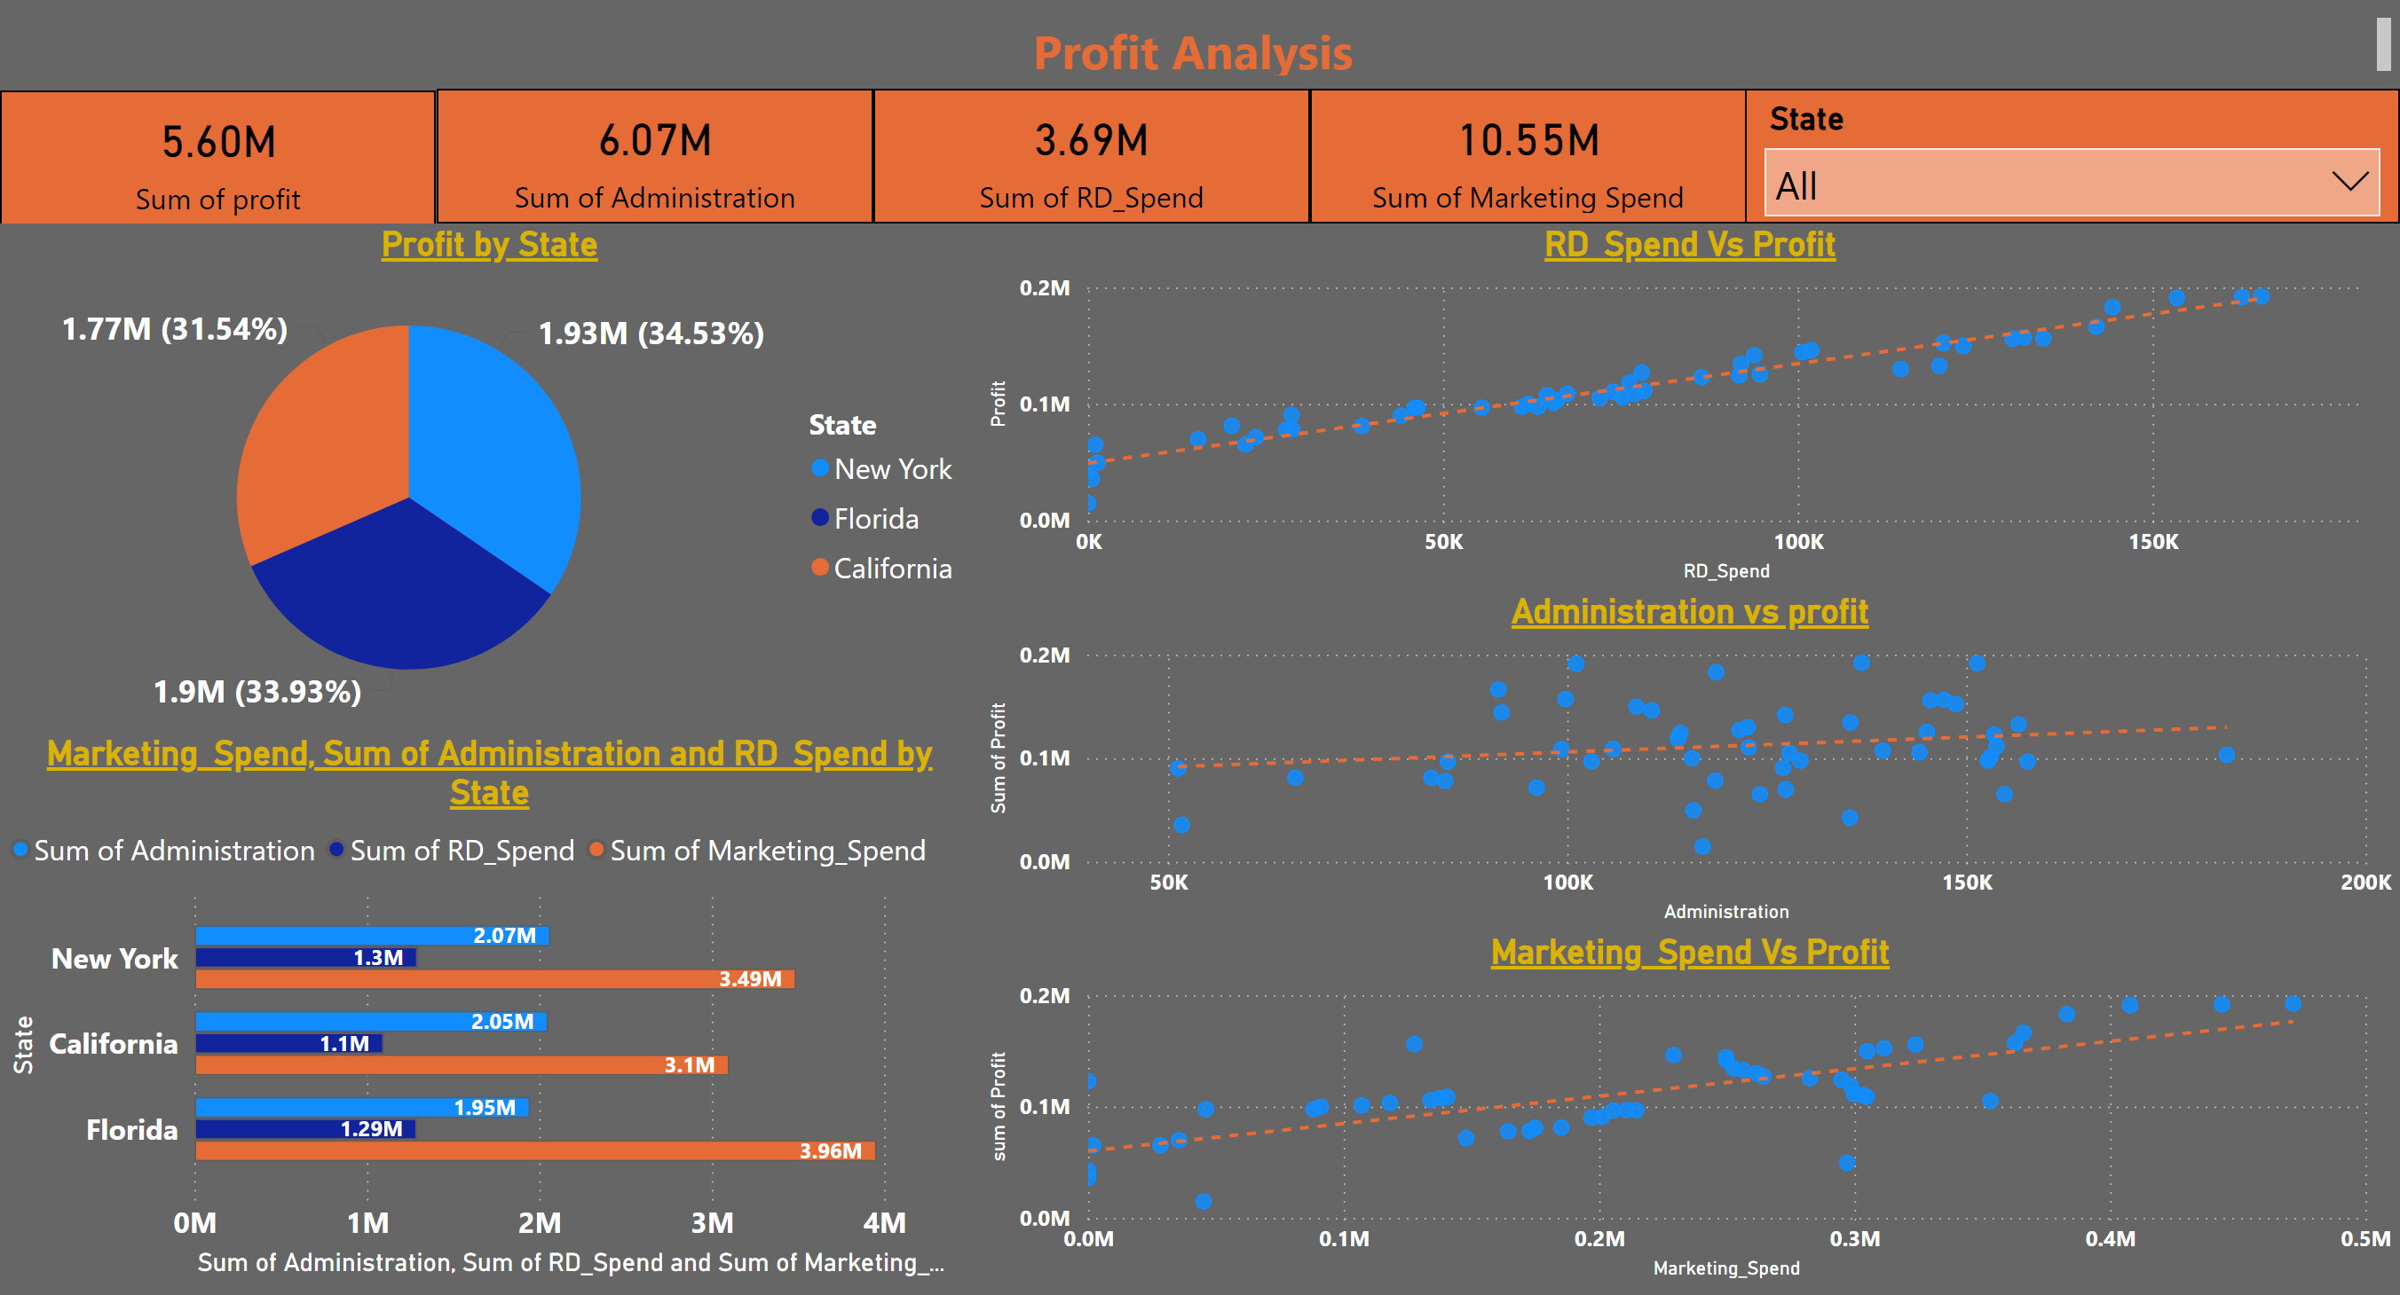
Page 6
Notes:
textbox
No alt text provided
card
No alt text provided
card
No alt text provided
card
No alt text provided
card
No alt text provided
slicer
No alt text provided
Profit by State
No alt text provided
RD_Spend Vs Profit
No alt text provided
Administration vs profit
No alt text provided
Marketing_Spend Vs Profit
No alt text provided
Marketing_Spend, Sum of Administration and RD_Spend by State
No alt text provided

Slide 8
The bar chart presents a comparison of spending across three categories (Marketing, Administration, and R&D) for different states: New York, California, and Florida. The insights drawn from the chart are:
New York: Marketing Spend : 3.49M
R&D Spend : 1.30M
Administration Spend : 2.07M
Observation:
New York has the highest R&D spend and administrative Spend among the three states, and moderate Marketing Spend.
2.Florida: Marketing Spend : 3.96M,
R&D Spend : 1.29M,
Administration Spend: 1 .95M
Observation:
Florida has the highest marketing spend overall, and moderate R&D investment, but its administration spending is lower than in other states..
3.California: Marketing Spend: 3.10M ,
R & D Spend: 1.10M ,
Administration spend : 2.05M
Observation:
California has a low Marketing spending, Moderate Administrative spend but its R&D spend is lower than in other states.

Slide 9
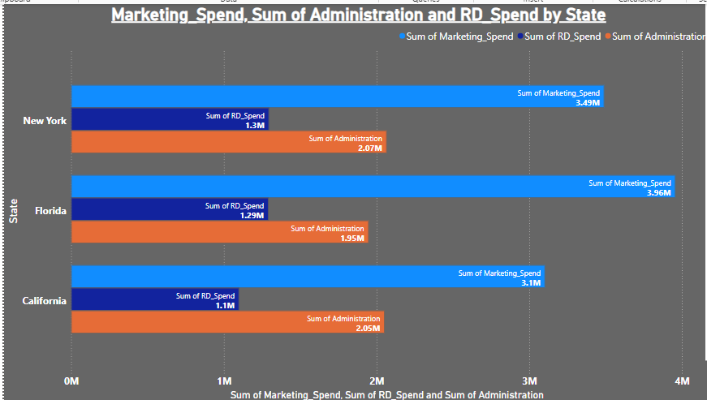

Slide 10
The pie chart shows the distribution of profits across three states: New York, Florida, and California. Here are the insights:
New York:
$1.93M in profit, accounting for 34.53% of the total profit.
New York contributes the highest Profit share among the three states.
Florida:
$1.9M in profit, representing 33.93% of the total.
Florida's profit is slightly lower than New York's, making it the second-largest contributor.
California:
$1.77M in profit, making up 31.54% of the total.
California has the lowest profit share, but the difference is marginal compared to the other states.

Slide 11
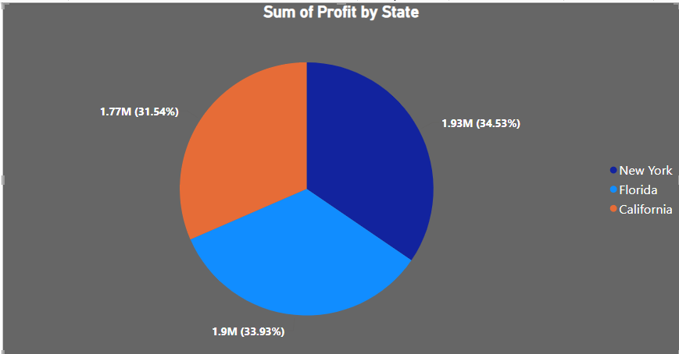

Slide 12
Correlation
 | RD Spend | Administration | Marketing Spend | Profit
RD Spend | 1
Administration | 0.241955245081689 | 1
Marketing Spend | 0.724248133053879 | -0.0321538751253866 | 1
Profit | 0.972900465659483 | 0.200716568268721 | 0.747765721741476 | 1

Slide 13
1. R&D Spend vs Profit:
Clear Positive Correlation: There is a strong positive trend between R&D Spend and Profit. As R&D spending increases, the profit increases consistently.
RD_Spend has a very strong positive correlation with Profit (0.97), indicating that as R&D spending increases, profit also increase significantly.
Insight: Investment in research and development appears to have a direct and strong impact on profitability. The more you invest in R&D, the more profit is generated.

Slide 14
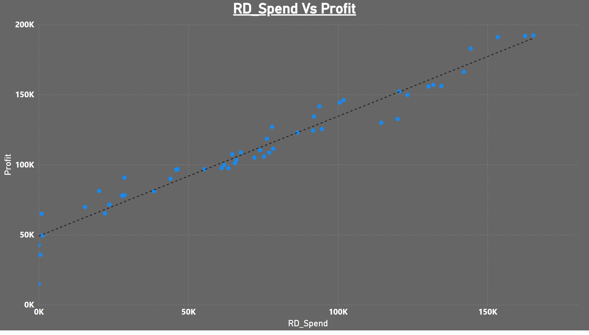
Page 5
Notes:
RD_Spend Vs Profit
No alt text provided

Slide 15
2.Marketing vs Profit:
Strong Positive Correlation: There is a strong positive trend between Marketing vs Profit scatter plot. There are some variations, but in general, higher Marketing spending also increase in profit.
Marketing_Spend also has a strong positive correlation with Profit (0.75).
RD_Spend and Marketing_Spend are fairly strongly correlated (0.72), indicating that companies with higher R&D spend tend to spend more on marketing as well.
Insight: Marketing spending has a strong positive effect on profit, but it is not as strong as the R&D spend. There may be diminishing returns on increased marketing expenses.

Slide 16
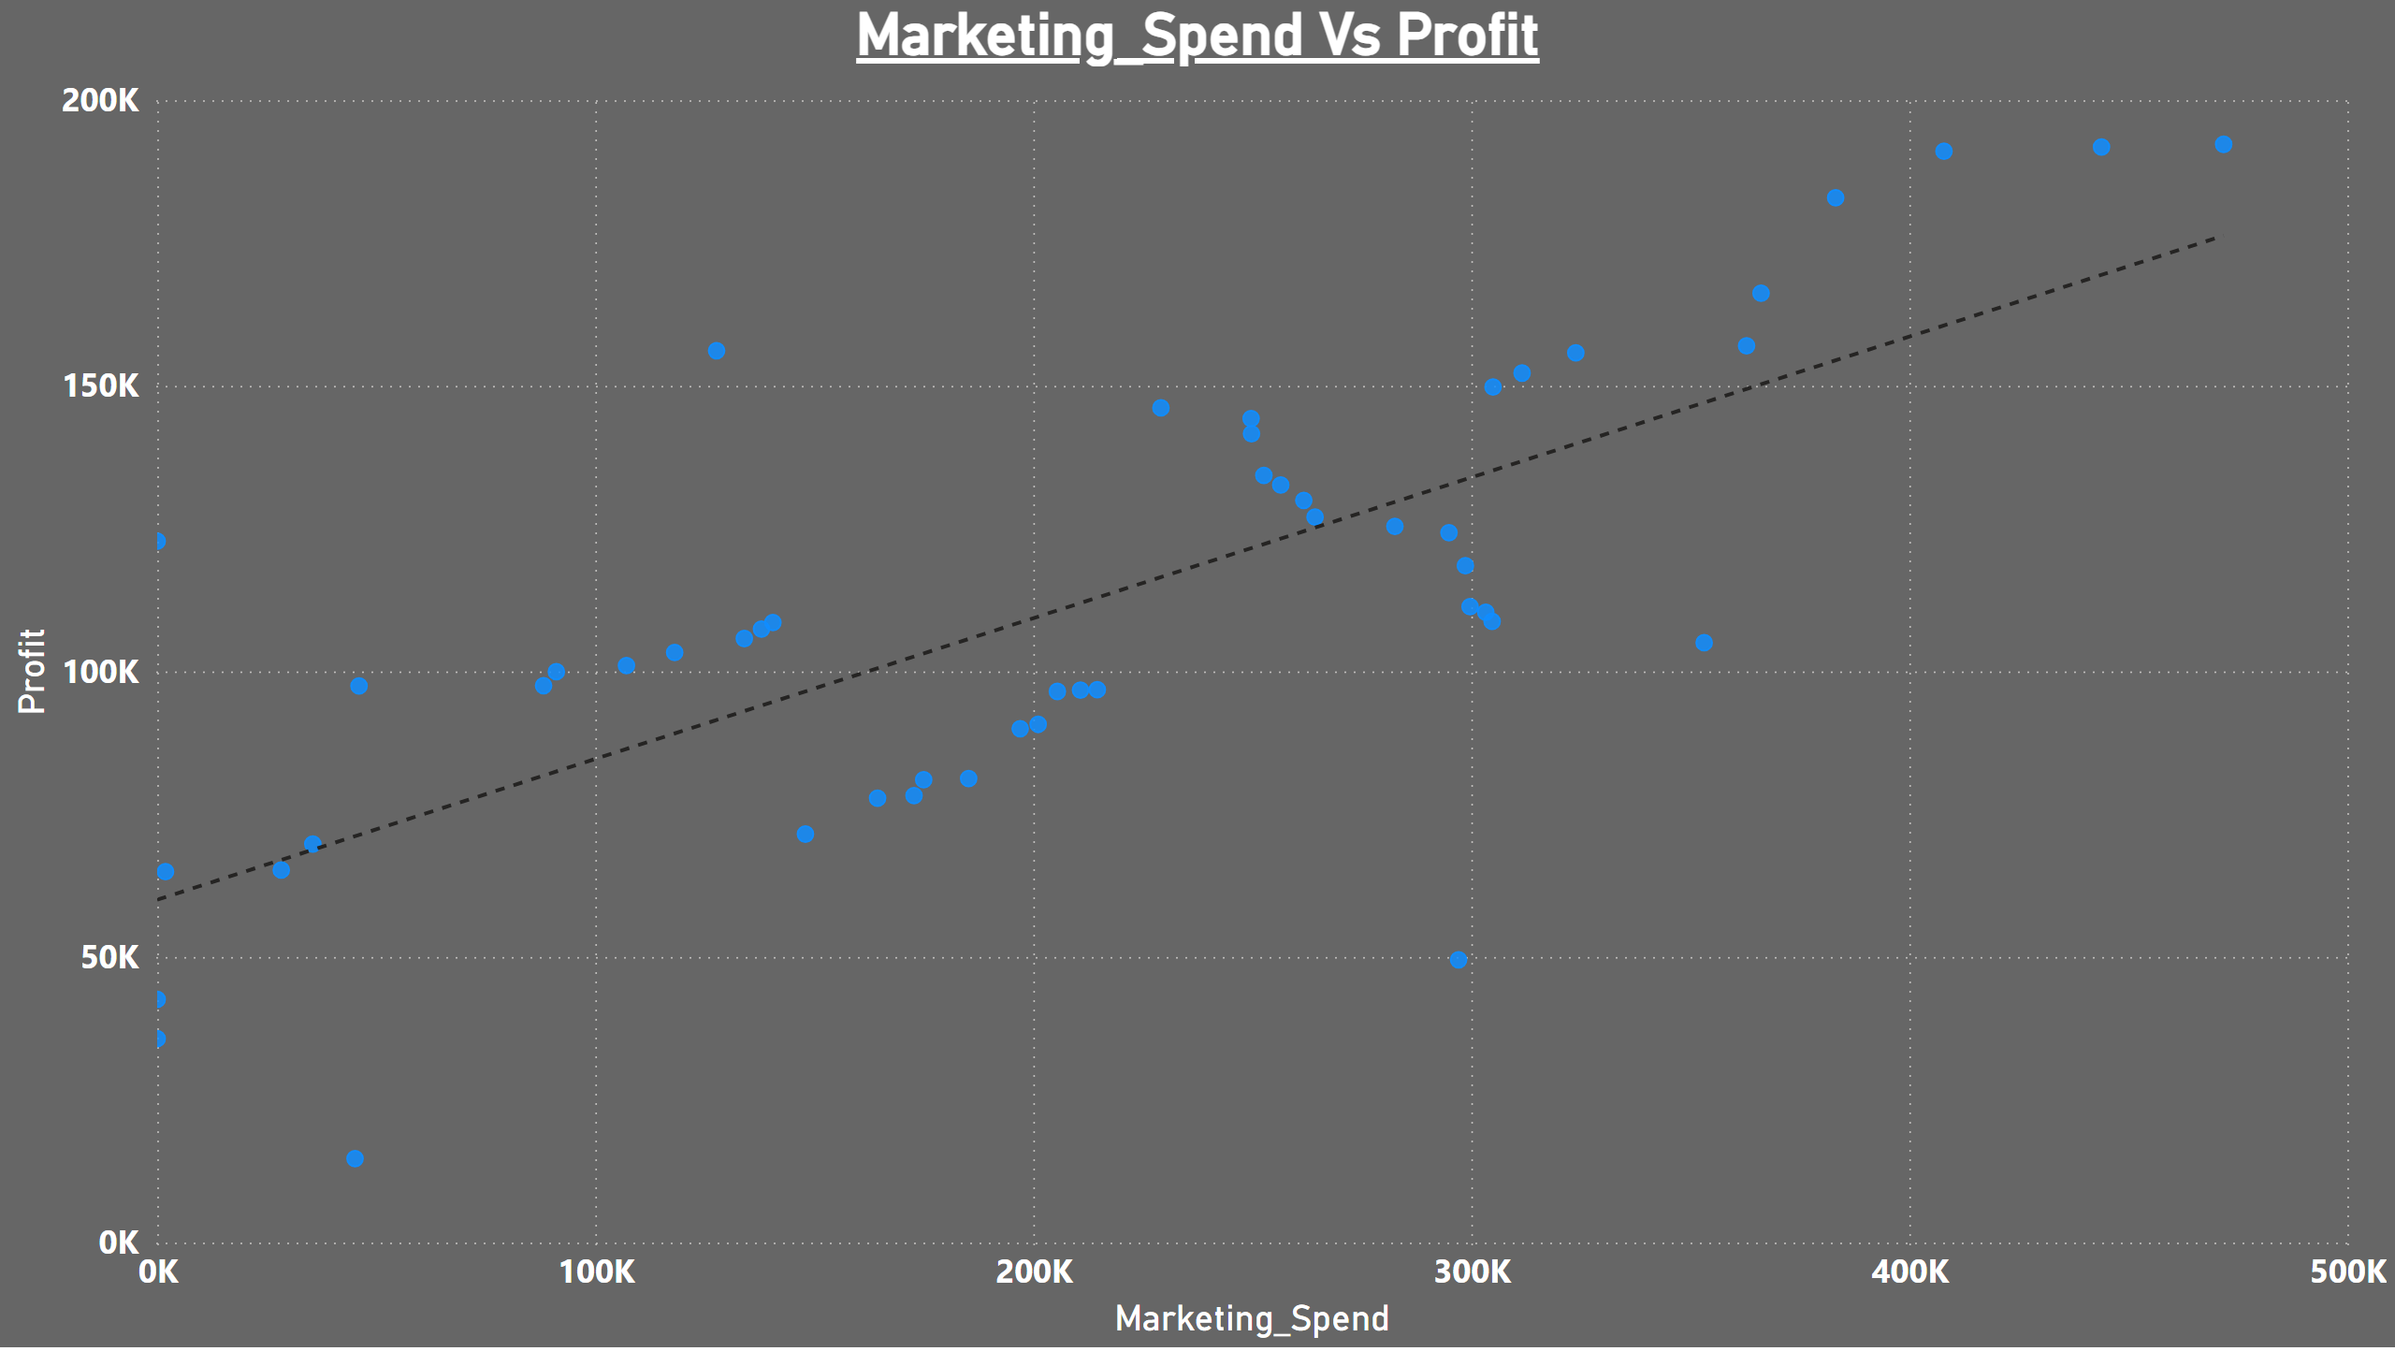

Slide 17
Administration vs Profit
No Strong Correlation: The data points for Administration Spend vs Profit are widely scattered, and there is no clear upward or downward trend. This indicates that changes in Administration Spend do not show a strong relationship with profit.
Administration has a weak positive correlation with Profit (0.20), less impact on profit.
Insight: Administration Spend does not seem to have a significant or consistent impact on profit. It might suggest that either the Administration strategies are not yielding immediate results, or other factors (like Administration conditions or product effectiveness) might be affecting the results.

Slide 18
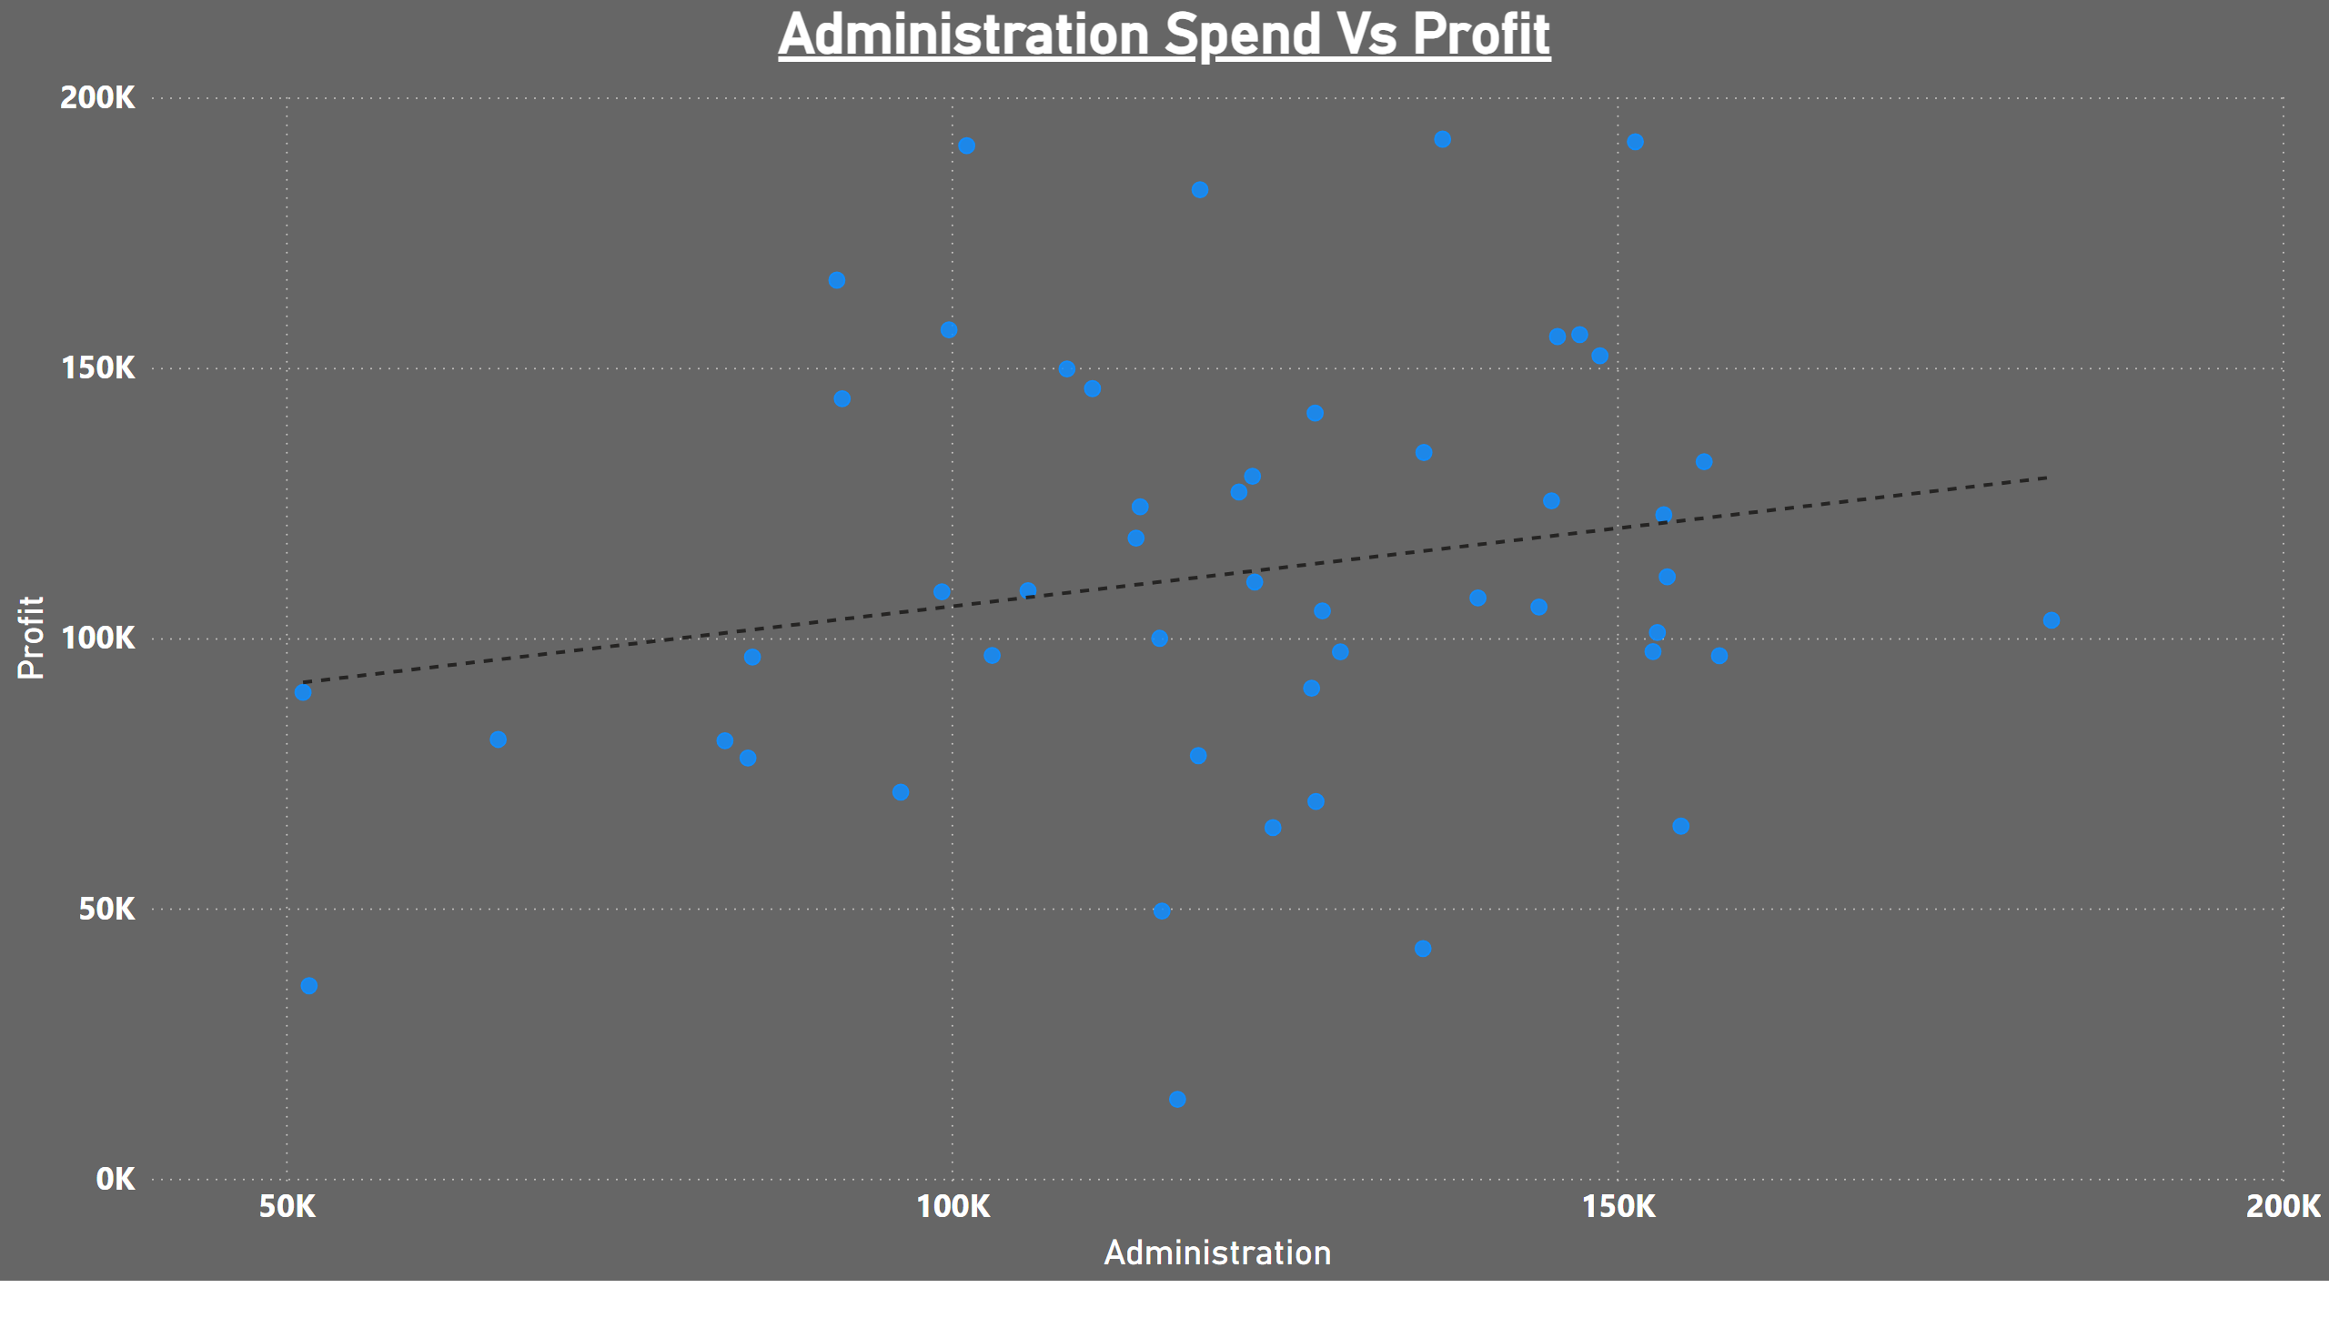

Slide 19
Conclusion:
R&D spending has a clear, positive correlation with profit, meaning investments here drive profitability.
Marketing spending shows a strong correlation, contributing somewhat to profit but with less impact then RD spend.
Administration spending shows no clear relationship with profit in this dataset, indicating the need for a deeper investigation into how marketing investments are influencing financial performance.

Slide 20
Thanking You

